Slide 1
KNIGHT NITE
CRITICAL DESIGN REVIEW
GROUP 6
Mark Atkins EE
Marcus Hobbs CPE
Ahkeim Pierre EE
Hieu Pham EE

Slide 2
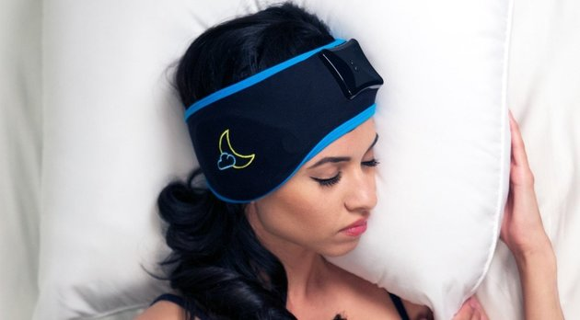
Motivation
Sleep deprivation negatively impacts quality of life and physical health
Fatigue due to lack of sleep is a direct cause of accidents and can be shown to negatively impact the economy
Many people take powerful narcotics to get to sleep every night
Many sleep aid devices on the market
There are no sleep aid devices that provide an active solution to the most common sleep disorder insomnia
http://www.huffingtonpost.com/entry/sleep-shepherd-blue_us_56ccb6d6e4b041136f188cde

Slide 3
Goals & Objectives
Monitor the user’s sleep environment
Track sleep cycles
Improve quality of sleep
Identify & treat the user’s sleep disorders

Slide 4
Requirements
Be able to measure:
Body Temperature
Body Movement
Ambient Temperature
Heart Rate
Ambient Sound
Ambient Light
Sound emergency alarm when heartbeat or breathing is not detected
Wake up user with lighting and sound at user-defined time
Provide cooling when forehead temperature goes above a threshold

Slide 5
Specifications
Component | Parameter | Design Specification
Cooling Patch | Temperature Control | 50-70 deg F
Temperature Sensor | Accuracy | +/- 0.5 deg F
Motion Sensor | Accuracy | 3 axes (x,y,z)
Heart Rate Monitor | Accuracy | 30-140 beats/min
LED’s | Brightness | 30-50 candelas
Microphone | Sensitivity | -44 ± 2 dB

Slide 6
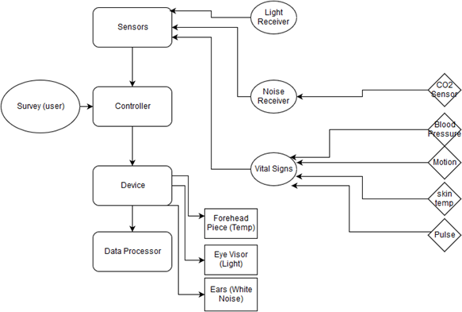
Monolithic Block Diagram

Slide 7
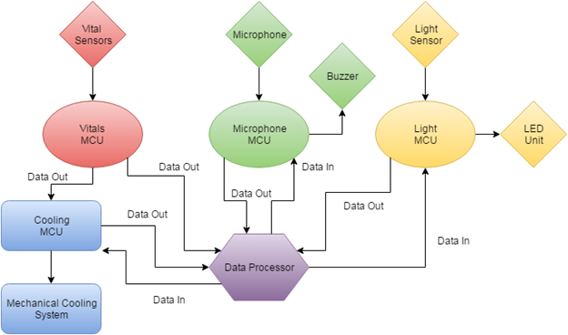
Modular Block Diagram

Slide 8
Implementation
Audio
Detect user snoring
Use various frequency tones in order to wake up the user
Vitals
Monitor user’s temperature, motion and heart rate behavior for data analysis
Lighting
Detect ambient light from environment
Generate light to wake user up in the morning
Cooling
Bring down the user’s temperature to help user fall asleep

Slide 9
Power Supply (PCB)

Slide 10
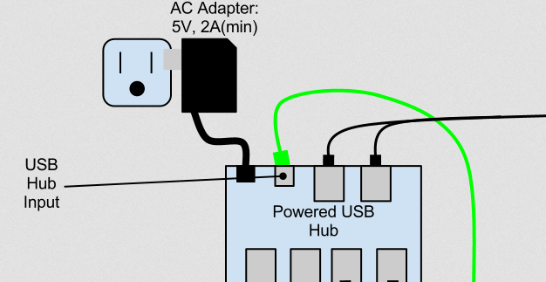
USB Central Hub
Every USB will supply each subsystem with 3-5Volts via the voltage regulator
Central Hub
Charge User’s phone
Transfer data collected from sensors to user’s device
Powered by AC to DC power adapter

Slide 11
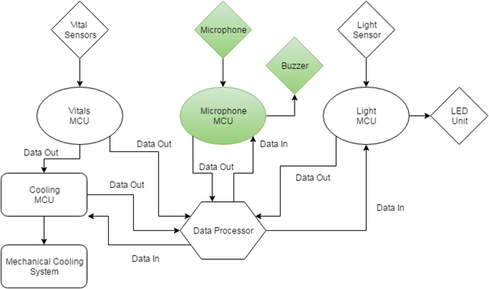

Slide 12
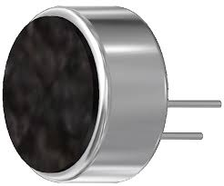
Microphone
AOM-4544P-2-R
Researched various microphone technologies such as piezoelectric, condenser, fiber optic, and carbon
Most snoring occurs at low frequencies: 20 - 300 Hz
Compared 3 different microphones
Requirements:
Sensitivity
High Signal Noise Ratio
Cost
AOM-4544P-2-R
Manufactured by: PUI Audio Inc.
Operating Voltage: 1.5 V
Signal to Noise Ratio: 60 dB
Sensitivity: -44 ± 2 dB
Cost: $1.76
4.5 mm (height)

Slide 13
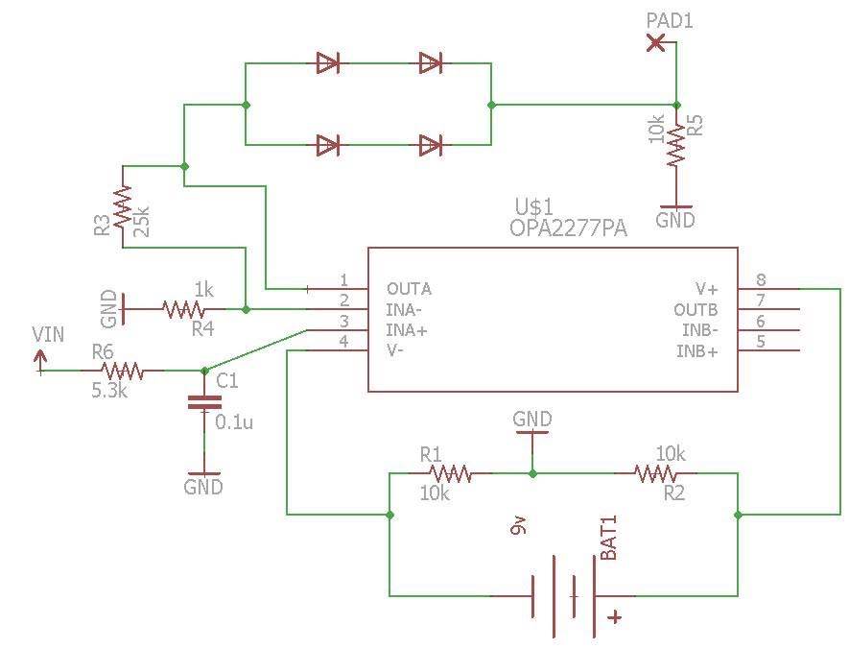
Microphone Schematic

Slide 14
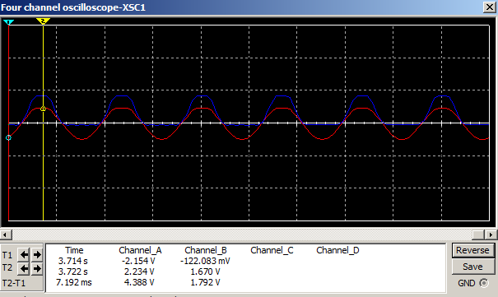
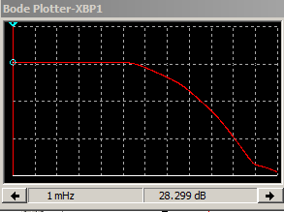
Output Signal
Full Wave Rectifier
Low Pass Filter

Slide 15
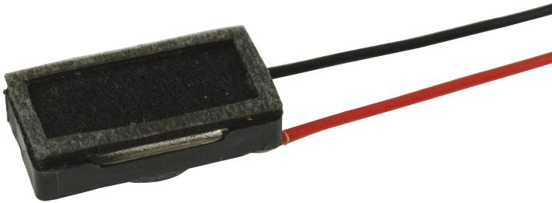
Alarm Unit
Electromagnetic type and the piezoelectric type are the two main buzzer categories researched in this project.
We only considered three piezoelectric buzzers when selecting parts for this project.
Requirements
Size
Range of frequencies
Pulse Tones
> 5 dB levels of the background noise
MCKP1206R1-4720
Manufactured by: PUI Audio Inc.
Frequency Range: 300 Hz - 3.4 kHz
Sensitivity : 115 ± 3 dB
Distortion: < 10% max
Rated Power: 10 mW

Slide 16
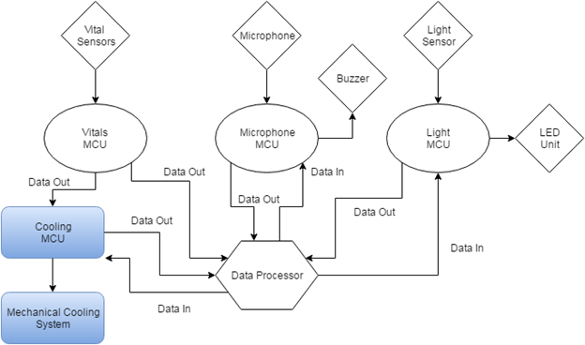

Slide 17
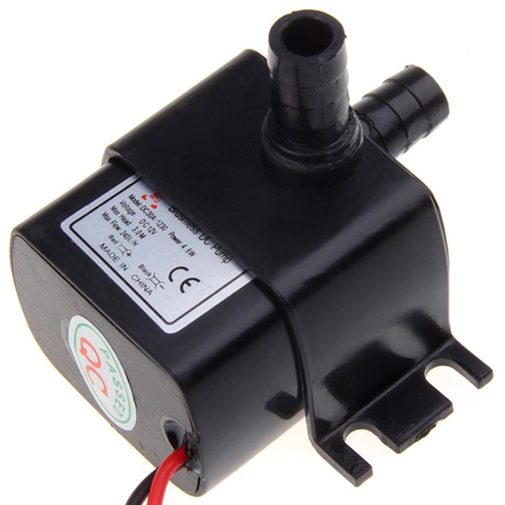
Cooling Unit
Researched different types of pumps for different existing applications
Vanderbilt Heart & Vascular Institute
American Academy of Sleep Research
Compare 3 pumps
Requirements
Flow Rate
Efficiency
Water Proof
Docooler Pump
12V DC
4.8W
240L/hour
Less than 35 dB
Water proof

Slide 18
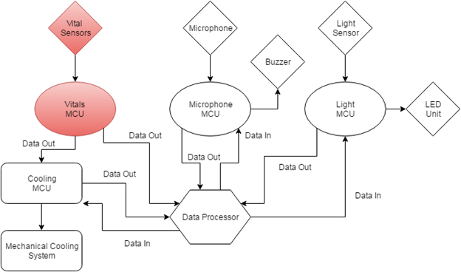

Slide 19
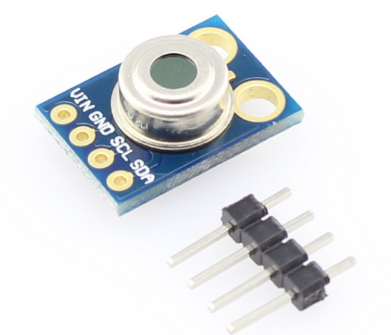
Temperature
Researched various types of temperature sensors such as infrared, thermocouple, thermistors
Compare 3 sensors
Requirements
Sensitivity
Accuracy
Compatibility
Melexis MLX90614 Sensor
10 bit Digital output
Operating Volttage: 3-5V
Operating Current: 2mA
Size: 9.1x9.1x2.1mm

Slide 20
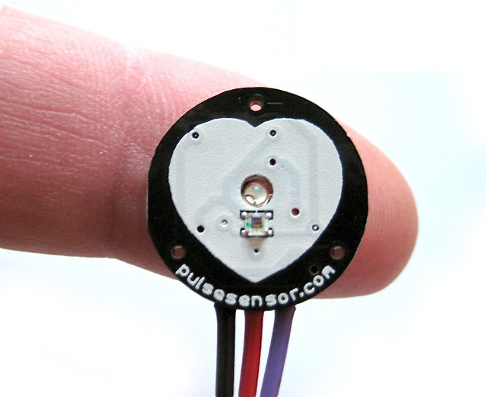
Heart Rate
Researched various methods of monitoring heart rate
Compare 3 sensors
Requirements
Sensitivity
Accuracy
Practicality
Pulsesensor© Heart Rate
Digital output
Operating Volttage: 3-5V
Small in size
Easy to Program

Slide 21
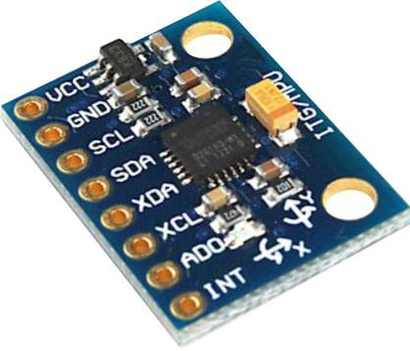
Motion
Researched various types of motion sensors such as gyroscopes and accelerometers
Compare 3 sensors
Requirements
Accuracy
Analyze 3-dimensional Movement
Invensense MPU6050
16 bit Digital Output
Operating voltage: 2.375-3.46V
Operating Current: 3.8mA
3 Axes of rotation

Slide 22
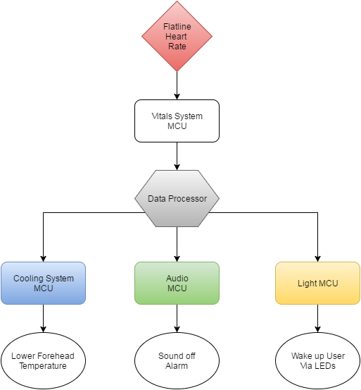
Emergency Wake-Up

Slide 23
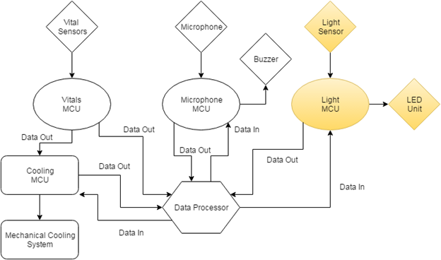

Slide 24
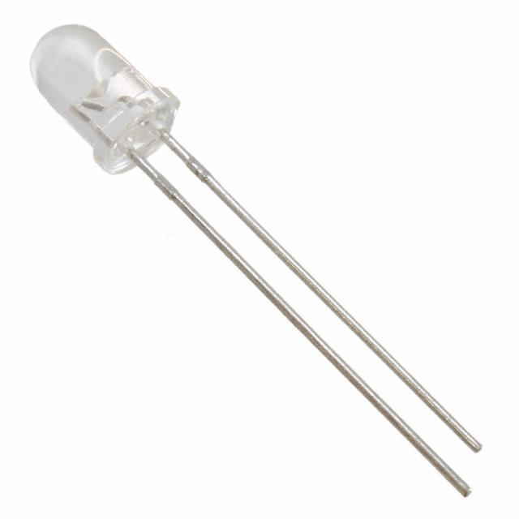
Lighting
Provides light to wake user up in the morning
Light is natural stimulus to wake the human body up
Lightweight and portable
LEDs used as main light source
WP710A10LBVC/D
Forward voltage: 2.65 V
Forward current: 2 mA
Cost effective
Battery powered
Controlled by MCU

Slide 25
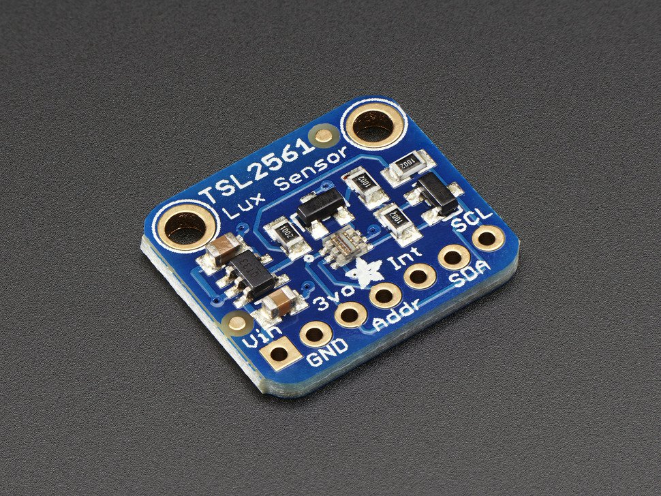
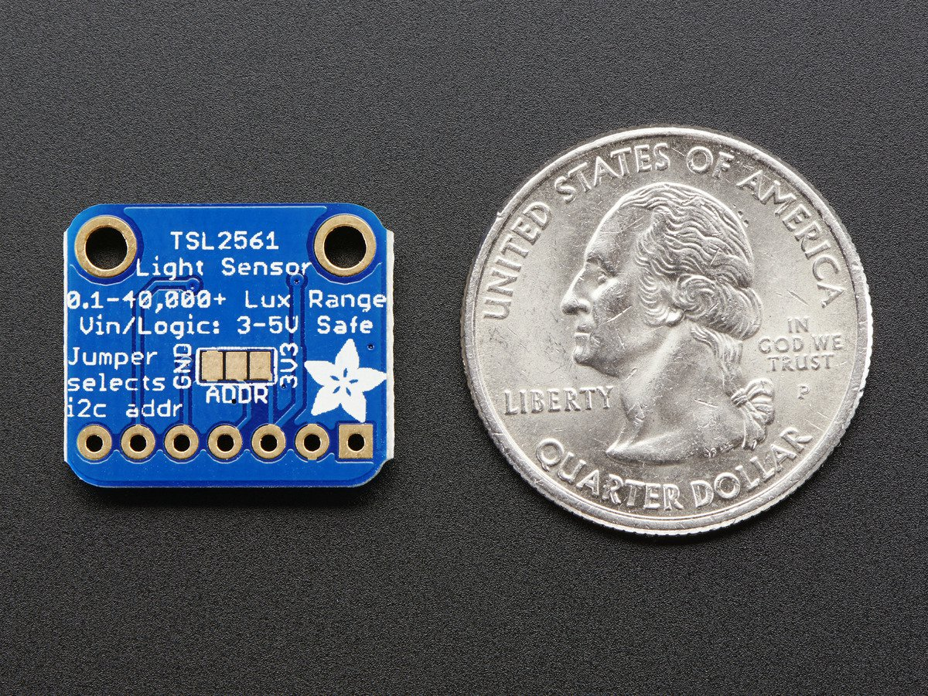
Light Sensor
Monitor ambient light while user is asleep
Compared 3 different sensors
Requirements:
Response time
Cost
Intensity range
Adafruit TSL2561 Digital Lux Sensor
16 bit digital output
Range: 0.1 to 40,000 Lux
Voltage range: 2.7 to 3.6 V
Interface: I2C
Cost: $5.95

Slide 26
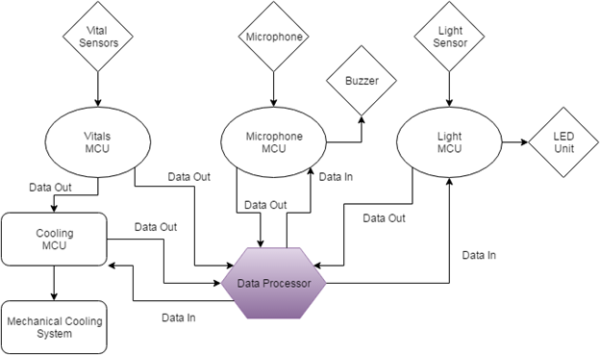

Slide 27
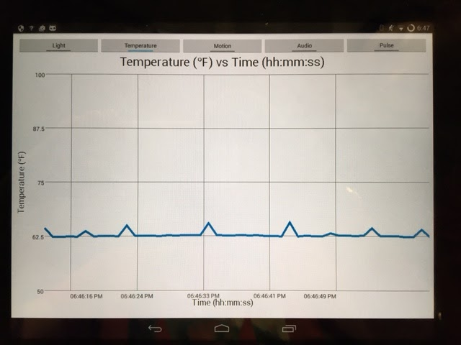
Data Processing
Android Mobile Device
Programming in Java
Implements system GUI
Connects to subsystems over USB
Reads normalized sensor values and control data from subsystems
Presents sensor data in engineering units with real-time graphs
Provides supervisory control of subsystems
Stores history of user sleep patterns

Slide 28
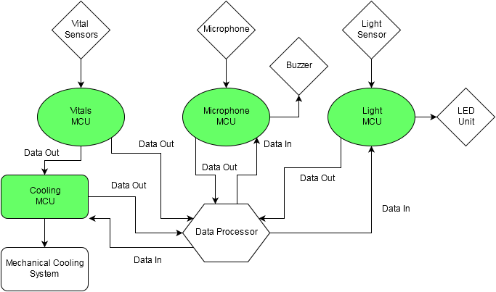

Slide 29
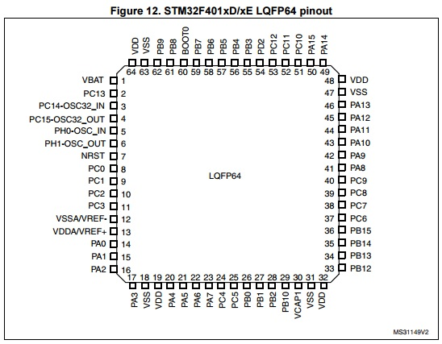
Microcontroller Selection
Each subsystem has a microcontroller
Selection criteria:
Floating-point unit
USB connectivity
Availability of development boards
Programming environment
Cost
Selected STM32F401RE Microcontroller
ARM 32-bit Cortex with FPU
512 KBytes Flash / 96 KBytes SRAM
81 I/O Ports with interrupt capability
USB 2.0 device controller
Program using IDE and C/C++/C#

Slide 30
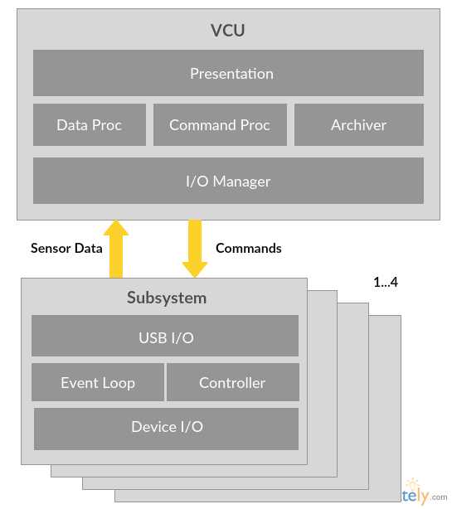
Software Design
Simple Layered Architecture
Data Processor (VCU) implements:
GUI
Data processing and archiving
Supervisory control of subsystems
I/O from USB
Each subsystem implements:
Polling and interrupt driven I/O to sensors
I2C, Analog
Automatic process control
I/O from USB

Slide 31
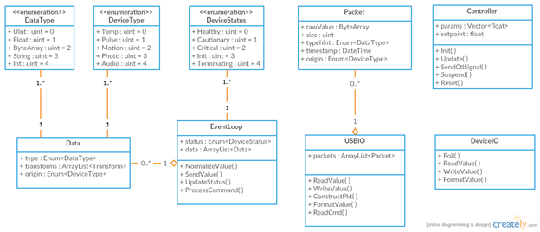
Class Diagram Subsystem

Slide 32
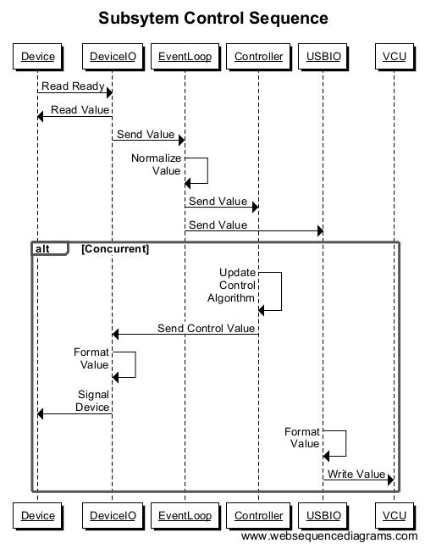

Slide 33
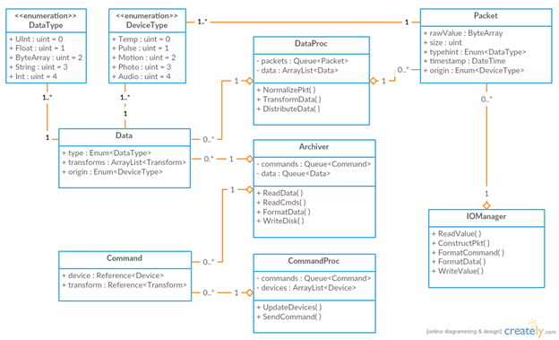
Class Diagram Data Processor

Slide 34
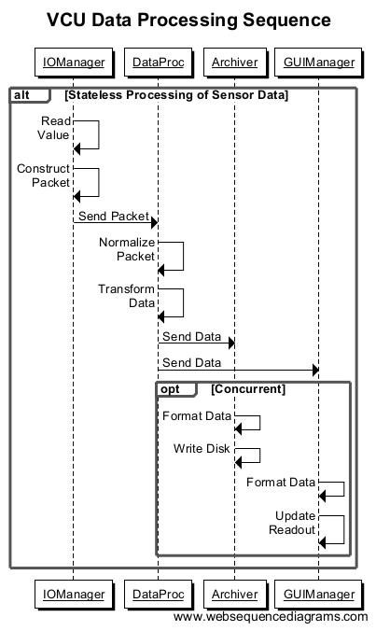

Slide 35
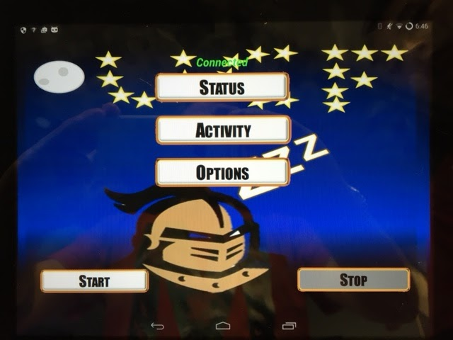
Graphical User Interface
Divided into main, activity, status, and alarms display
Main - Application functions
Activity - Real-time graphs
Status - Subsystem status and control
Options - User configurable alarms

Slide 36
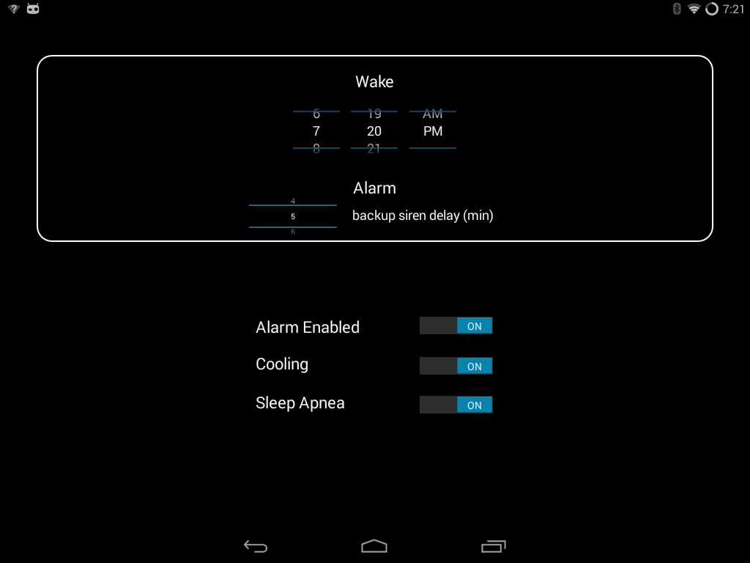
Graphical User Interface

Slide 37
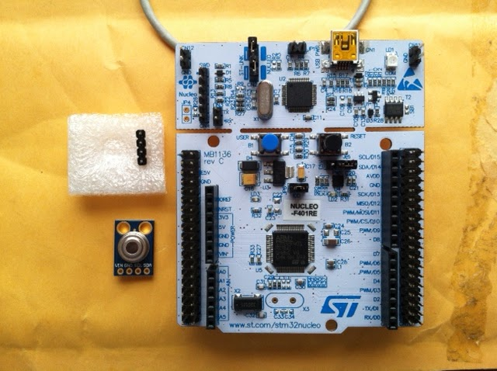
Prototyping
STM32F401 Nucleo-64
Programming and debugging tool integrated on board
Eclipse based IDE programming in C/C++
Power and programming/debugging over USB
Infrared Thermometer MLX90614
Communicates with MCU over I2C bus
Android Mobile Device
Programming in Android Studio using Java
Reads temp values from MCU over USB

Slide 38
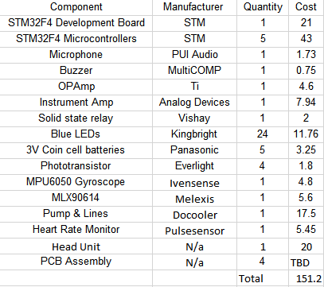
Budget

Slide 39
Schedule
April | Complete Senior Design I Documentation
May | Order parts for prototype assembly
 | CDR Presentation
 | Begin prototype assembly
 | Order Subsystems Printed Circuit Boards
June | Begin Prototype Testing
 | Write Conference Paper
 | Finalize Prototype Testing
 | Assemble final unit
July | Begin testing with finished unit
 | Finish Final Documentation
 | Prepare for Final Presentation
August | GRADUATE!!!

Slide 40
Work Distribution
Marcus (CpE) | Hieu (EE) | Ahkeim (EE) | Mark (EE)
MCU | Vitals | LEDs | Audio
Data Processing | Cooling | Power | Power

Slide 41
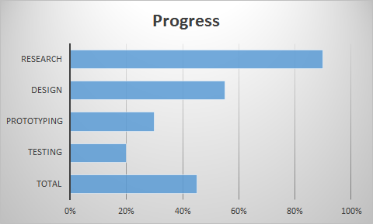
Group Progress

Slide 42
Concerns
Size of sub-assemblies
Keeping water reservoir cold
Data processing
Routing wires around user’s head
Encasing of hardware

Slide 43
Questions

